Slide 1


TOP 500 Movie API EXPLORER
Created by:
Alvin - Thanh Vinh Giang
Frank - Hao Nguyen
Uth - Uthpalie Thilakaratna
Tam - Tammy Powell
Are you looking for a movie to watch?
Are you wondering what are the top 500 movies from the last 5 years?
Are you wondering what are the top 10 foreign language movies?
STEP INSIDE OUR DATABASE

Slide 2




Our Source
URL: https://developer.themoviedb.org/reference/discover-movie
ETL
Extracting Data
Data Organising / Transforming
Data Loading
Why SQL
FLASK API & our additional unknown library
Our additional unknown Library
Seaborn

Slide 3






Our ERD

Slide 4
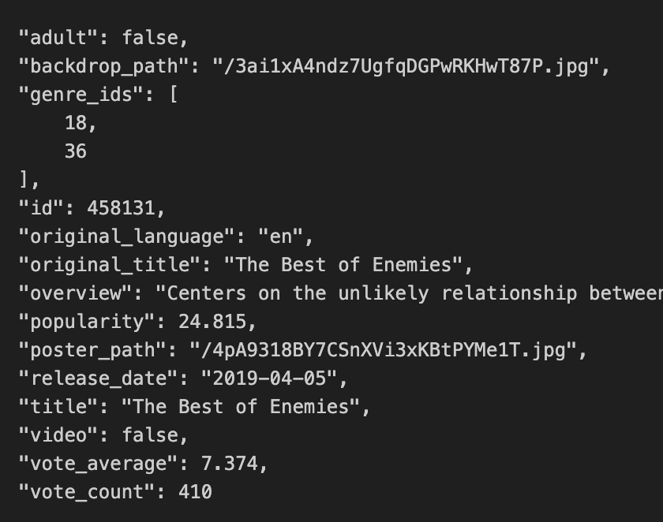
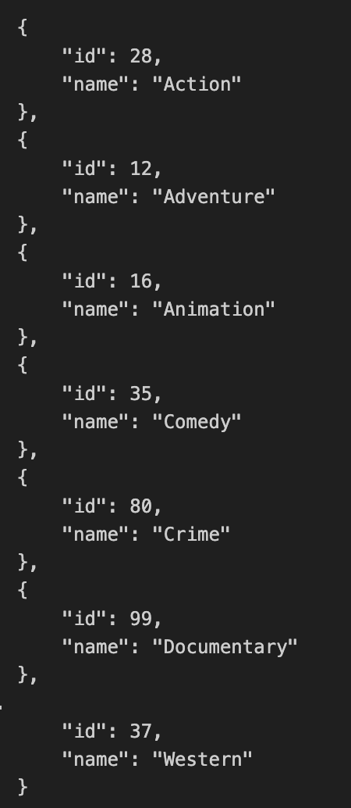
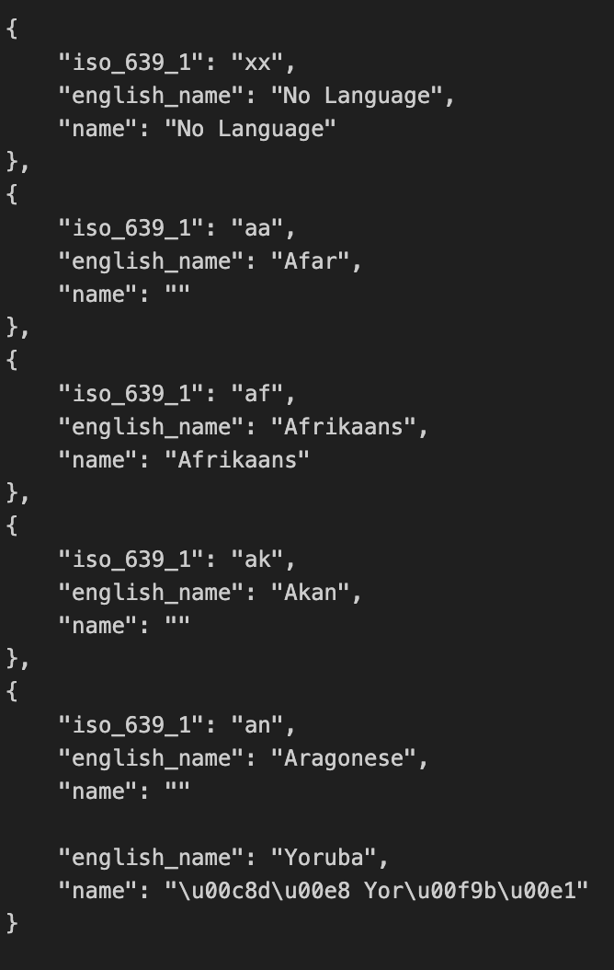
Extracting
3 API Endpoints
Movies
Genres
Languages

Slide 5
Transforming
Correcting errors
Data Cleaning
Dropping unnecessary columns
Renaming and reorganising columns

Slide 6
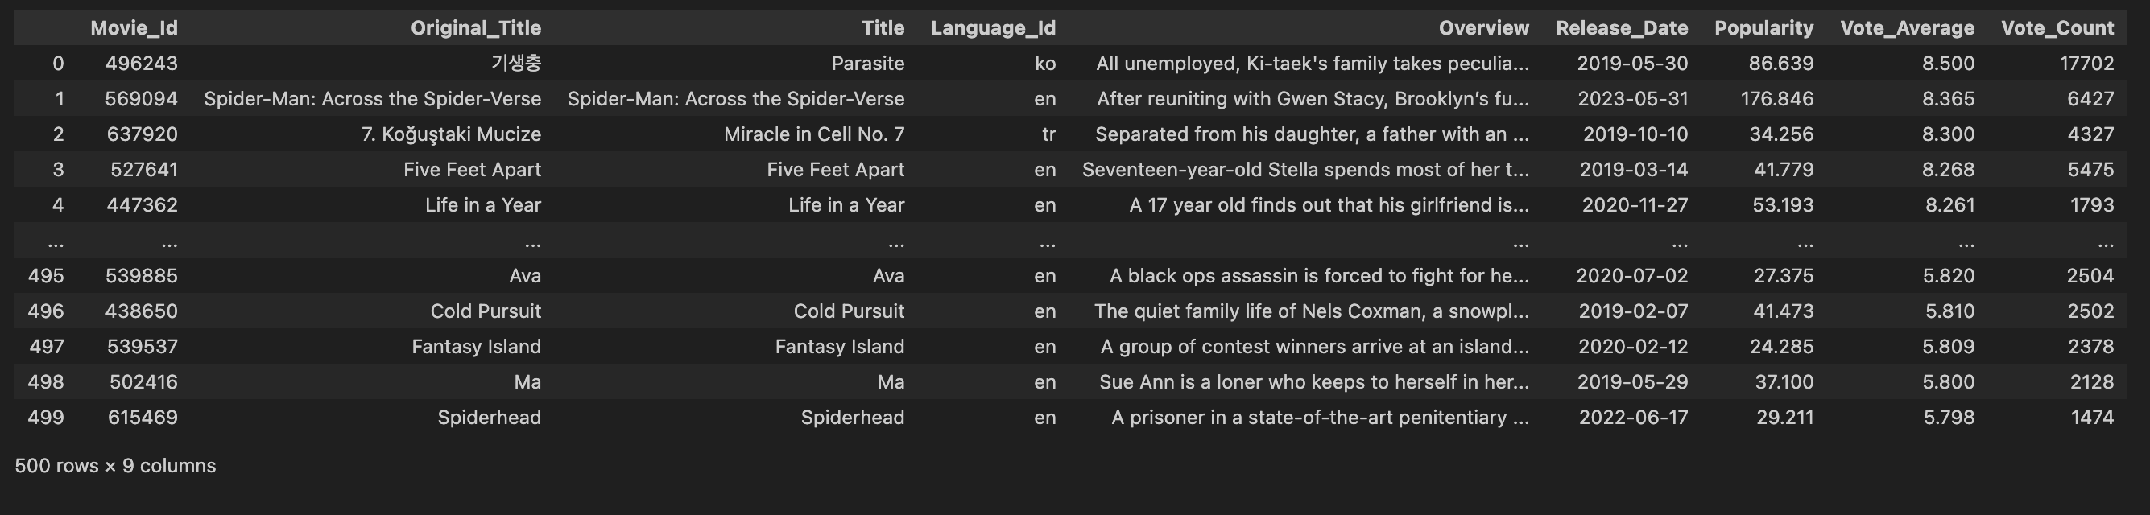
Transforming
Data Filtering
Movies have more than 1000 votes
Data Sorting
Sort by Vote Average in descending order

Slide 7
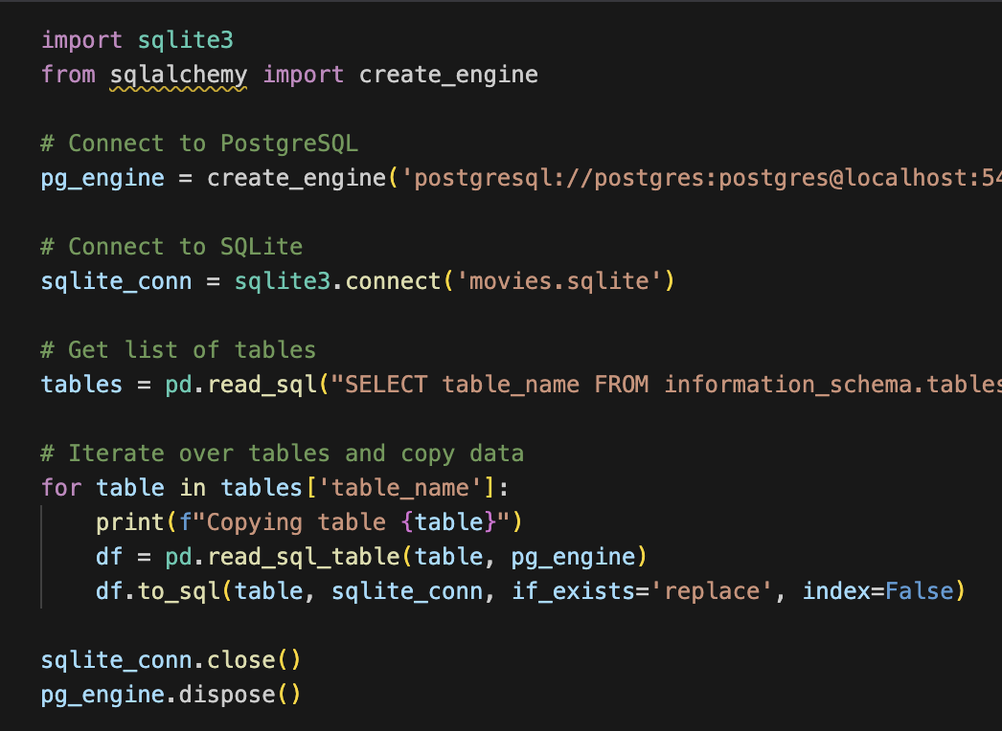
Loading
Create table Schemas
Import csv files
CSV files
PostgreSQL
Data frames
SQLite database file

Slide 8


